Slide 1
JAC444 - Lecture 4
Segment 1 - Exception

Slide 2
Objectives
Upon completion of this lecture, you should be able to:
Separate Error-Handling Code from Regular Code
Use Exceptions to Handle Exceptional Events
Create Your Exceptions

Slide 3
Exceptions
In this lesson you will be learning about:
What is and how to treat an exception in Java
How to separate error handling from regular code
How to write exception handler
Exception class hierarchy
How to create your own exception classes

Slide 4
Motivation
When a program runs into a runtime error, the program terminates abnormally. How can you handle the runtime error so that the program can continue to run or terminate gracefully?

Slide 5
What is an exception?
•
Definition: An exception is an event that occurs during the execution of a program that disrupts the normal flow of instruction.
Examples: Serious hardware errors, such as a hard disk crash, to simple programming errors, such as trying to access an out-of-bounds array element.
Java Solution: The Java method creates an exception object and hands it off to the runtime system.

Slide 6
Definitions
Throwing an Exception
It happens when an error occurs the method creates an exception object and hands it off to the runtime system.
Throwing Exception object
The exception object contains information about the exception, including its type and the state of the program when the error occurred.
Catching an Exception
Searching the the call stack until an appropriate exception handler is found. The handler catches the exception.

Slide 7
Exception Types

Slide 8
System Errors
System errors are thrown by JVM and represented in the Error class. The Error class describes internal system errors. Such errors rarely occur. If one does, there is little you can do beyond notifying the user and trying to terminate the program gracefully.

Slide 9
Exceptions
Exception describes errors caused by your program and external circumstances. These errors can be caught and handled by your program.

Slide 10
Runtime Exceptions
RuntimeException is caused by programming errors, such as bad casting, accessing an out-of-bounds array, and numeric errors.

Slide 11
Advantages of Exceptions
Separating Error Handling Code from “Regular” Code
Propagating Errors Up the Call Stack
Grouping Error Types and Error Differentiation

Slide 12
Error Handling Code
Problem: Read a file and copy its content into memory
… readFile ( … ) {
open the file; determine its size;
allocate that much memory; read the file into memory; close the file;
…
}

Slide 13
Potential Errors
What happens if the file can not be opened?
What if the length of the file can not be determined?
What happens if enough memory can not be allocated?
What happens if the read fails?
What happens if the file can not be closed?

Slide 14
Error Detection Code Solution
int readFile ( … ) { initialize errorCode = 0;
//open the file;
if (theFileIsOpen) {
//determine the length of the file; if (gotTheFileLength) {
//allocate that much memory; if (gotEnoughMemory) {
//read the file into memory; if (readFailed) {
errorCode = -1;
}
} else { errorCode = -2;
}
} else { errorCode = -3;
}
…

Slide 15
Java Solution: Exception Handler
void readFile() {
try {
open the file; determine its size;
allocate that much memory; read the file into memory; close the file;
} catch (fileOpenFailed) { doSomething;
} catch (sizeDeterminationFailed) { doSomething;
} catch (memoryAllocationFailed) { doSomething;
} catch (readFailed) {
doSomething;
} catch (fileCloseFailed) { doSomething; …

Slide 16
Exception Hierarchy
All exceptions that are thrown within a Java program are first-class objects.
Leaf class (a class with no subclasses) represents a specific type of exception.
Node class (a class with one or more subclasses) represents a group of related exceptions.
Node Exception
Leaf Exception
Leaf Exception

Slide 17
Exception Types

Slide 18





ArrayException Example
Exception
ArrayException
InvalidIndexExceptio n
NoSuchElementException
ElementTypeException

Slide 19
Types of Exceptions
There are basically two types of Exceptions
Checked Exceptions
Unchecked Exceptions
But according to Sun microsystems there is a third type exception as well.
Error

Slide 20
Checked Exceptions
The classes that extend Throwable class except RuntimeException and Error are known as checked exceptions e.g.IOException, SQLException etc. Checked exceptions are checked at compile-time.
Exception Name | Description
ClassNotFoundException | Class not found.
CloneNotSupportedException | Attempt to clone an object that does not implement the Cloneable interface.
IllegalAccessException | Access to a class is denied.
InstantiationException | Attempt to create an object of an abstract class or interface.
InterruptedException | One thread has been interrupted by another thread.
NoSuchFieldException | A requested field does not exist.
NoSuchMethodException | A requested method does not exist.

Slide 21
UnChecked Exceptions
The classes that extend RuntimeException are known as unchecked exceptions e.g. ArithmeticException, NullPointerException, ArrayIndexOutOfBoundsException etc. Unchecked exceptions are not checked at compile-time rather they are checked at runtime.
Exception Name | Description
ArithmeticException | Arithmetic error, such as divide-by-zero.
ArrayIndexOutOfBoundsException | Array index is out-of-bounds.
ArrayStoreException | Assignment to an array element of an incompatible type.
ClassCastException | Invalid cast.
IllegalArgumentException | Illegal argument used to invoke a method.
IllegalMonitorStateException | Illegal monitor operation, such as waiting on an unlocked thread.
IllegalStateException | Environment or application is in incorrect state.

Slide 22
IllegalThreadStateException | Requested operation not compatible with the current thread state.
IndexOutOfBoundsException | Some type of index is out-of-bounds.
NegativeArraySizeException | Array created with a negative size.
NullPointerException | Invalid use of a null reference.
NumberFormatException | Invalid conversion of a string to a numeric format.
SecurityException | Attempt to violate security.
StringIndexOutOfBounds | Attempt to index outside the bounds of a string.
UnsupportedOperationException | An unsupported operation was encountered.

Slide 23
Exception Types
Checked Exceptions
Un Checked Exceptions

Slide 24
Java Exception: Catch / Specify
Java language r equires that methods either:
C atch
or
S pecify
an exception (checked exceptions)
If an exception is not caught or specified by a method the program does NOT compile

Slide 25
Java Solution: Catch or Specify
₁ public printString(...) {
try {
Catch
findString(...);
} catch (Exception e) { doErrorProcessing(...);
}
}
Specify
2 public findString(...) throws readFile(...);
}
Exception {
₃ public readFile(...) throws Exception { if (...) throw new Exception();
}

Slide 26
Catch / Specify
Catch
A method can catch an exception by providing an exception handler type of exception
Specify
The method could specify that it can throw that exception

Slide 27
How to Write an Exception Handler
There are five keywords in Java to be used for Exception Handling.
try
catch
finally
throw
throws

Slide 28
How to Write an Exception Handler
Write the try block
It is a block that encloses the statements that might throw an exception
Write the catch block(s)
It is used to handle the Exception associated with try block. Multiple catch blocks can be written for a single try block.
Write the finally block
finally block provides a mechanism that allows your method to clean up after itself

Slide 29
The try Block
try {
Java statements
}
Example:
PrintWriter out = null; try {
out = new PrintWriter ( new FileWriter(“X”)); for (int i = 0; i < size; i ++)
System.out.println(vector.elementAt(i));
}
Important note:
A try statement must be accompanied by at least one
catch block or one finally block.

Slide 30
Example Try and Catch
Not handled
public class Testtrycatch1{
public static void main(String args[]){
int data=50/0;//may throw exception
System.out.println("rest of the code...");
}
}
Exception in thread main java.lang.ArithmeticException:/ by zero
Handled with Try and Catch
public class Testtrycatch2{
public static void main(String args[]){
try{
int data=50/0;
}catch(ArithmeticException e){System.out.println(e);}
System.out.println("rest of the code...");
}
}
Exception in thread main java.lang.ArithmeticException:/ by zero rest of the code...

Slide 31
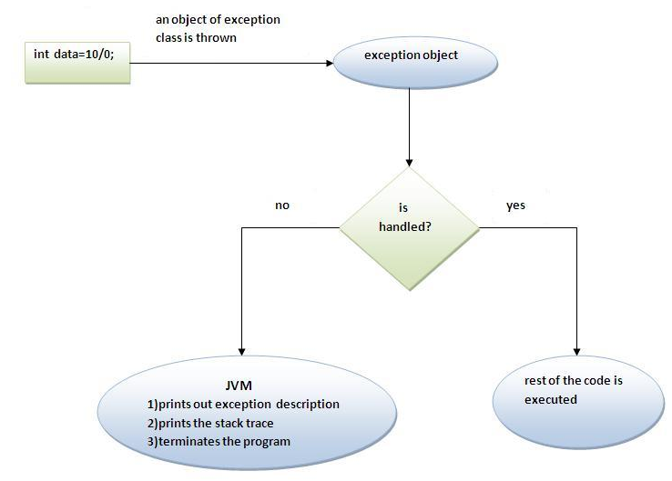
Internal working of Java try-catch

Slide 32
The catch Block(s)
One associates exception handlers with a try statement by providing one or more catch blocks directly after the try block:
try {
. . .
} catch ( . . . ) {
. . .
} catch ( . . . ) {
. . .
} . . .
The general form of catch statement:
catch(ThrowableClass variableName) { Java statements
}
Catch statement requires a single formal argument.

Slide 33
Example catch Block(s)
public class TestMultipleCatchBlock{
public static void main(String args[]){
try{
int a[]=new int[5];
a[5]=30/0;
}
catch(ArithmeticException e){System.out.println("task1 is completed");}
catch(ArrayIndexOutOfBoundsException e){System.out.println("task 2 completed");}
catch(Exception e){System.out.println("common task completed");}
System.out.println("rest of the code...");
}
}
Output:task1 completed
rest of the code...

Slide 34
Rules for Multiple Catch
Rule 1: At a time only one Exception is occurred and at a time only one catch block is executed.
Rule 2: All catch blocks must be ordered from most specific to most general i.e. catch for ArithmeticException must come before catch for Exception.
Q: How can we handle both Exceptions in the last Example at the same time?

Slide 35
Java Nested Try Blocks
Class MultiTry{
public static void main(String args[]){
try{
try{
System.out.println("going to divide");
int b =39/0;
}catch(ArithmeticException e){System.out.println(e);}
try{
int a[]=new int[5];
a[5]=4;
}catch(ArrayIndexOutOfBoundsException e){System.out.println(e);}
System.out.println("other statement”);
}catch(Exception e){System.out.println("handeled");}
System.out.println("normal flow..");
}
}
going to divide
java.lang.ArithmeticException: / by zero
java.lang.ArrayIndexOutOfBoundsException: 5
other statement
normal flow..

Slide 36
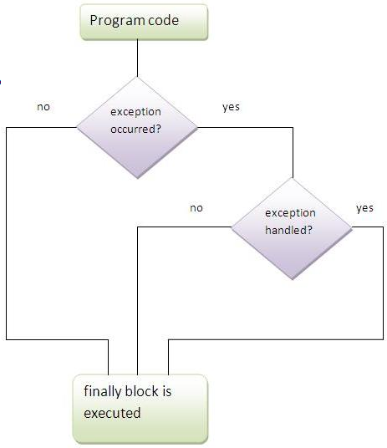
The finally Block
finally block is used to execute code like, closing connection, closing file etc.
Always executed whether exception is handled or not.
Followed by Try and Catch block.
For each Try there can be zero or more Catch blocks, but always one Finally block.

Slide 37
Exception Doesn’t occur
class TestFinallyBlock{
public static void main(String args[]){
try{
int data=25/5;
System.out.println(data);
}
catch(NullPointerException e){System.out.println(e);}
finally{System.out.println("finally block is always executed");}
System.out.println("rest of the code...");
}
}
Output:
5
finally block is always executed
rest of the code...

Slide 38
Exception occurs and Not Handled
class TestFinallyBlock1{
public static void main(String args[]){
try{
int data=25/0;
System.out.println(data);
}
catch(NullPointerException e){System.out.println(e);}
finally{System.out.println("finally block is always executed");}
System.out.println("rest of the code...");
}
}
Output:
finally block is always executed
Exception in thread main java.lang.ArithmeticException:/ by zero

Slide 39
Exception occurs and Handled
public class TestFinallyBlock2{
public static void main(String args[]){
try{
int data=25/0;
System.out.println(data);
}
catch(ArithmeticException e){System.out.println(e);}
finally{System.out.println("finally block is always executed");}
System.out.println("rest of the code...");
}
}
Output:
Exception in thread main java.lang.ArithmeticException:/ by zero
finally block is always executed
rest of the code...

Slide 40
Try, Catch, Finally Blocks
Jordan Anastasiade – Java Programming Language Course 22
public void writeList ( ) { PrintWriter out = null;
try {
System.out.println(“Entering try statement”);
out = new PrintWriter(new FileWriter(“OutFile.txt”)); for (int i = 0; i < size; i++)
out.println (“At:“ + i + “ = “ + vector.elementAt(i));
} catch (ArrayIndexOutOfBoundsException e) { System.err.println(“Caught Exception: “ e.getMessage( ));
} catch (IOException e) {
System.err.println(“Caught IOException: “ + e.getMessage( ));
} finally {
if (out ! = null) { System.out.println(“Closing PrintWriter”); out.close ( );
} else {
System.out.println(“PrintWriter not open:);
}
}
}

Slide 41
throw keyword
Used to explicitly throw an Exception.
Checked or unchecked exception can be thrown using the keyword.
The throw satement is used to create an exception object.
throw new exception;
public class TestThrow1{
static void validate(int age){
if(age<18)
throw new ArithmeticException("not valid");
else
System.out.println("welcome to vote");
}
public static void main(String args[]){
validate(13);
System.out.println("rest of the code...");
}
}
Output:
Exception in thread main java.lang.ArithmeticException:not valid

Slide 42
Specifying Exceptions
One can specify exceptions in the method definition with the keyword:
Throws exception
The throws clause is composed of the throws keyword followed by a comma-separated list of all the exceptions thrown by method.
Example:
public void writeList(...)throws IOException,
ArrayIndexOutOfBoundsException{
...
}
Jordan Anastasiade – Java Programming Language Course
24

Slide 43
The Throwable Class
throw | throws
Used to explicitly throw exception. | Used to declare an exception.
Checked exception cannot be propagated using throw only. | Checked exception can be propagated with throws.
Followed by an instance. | Followed by a class.
Used within the method. | Used with the method signature.
Cannot throw multiple exceptions. | can declare multiple exceptions e.g. public void method()throws IOException,SQLException.

Slide 44
final finally finalize
Is a keyword | Is a block | Is a method
Final is used to apply restrictions on class, method and variable. Final class can't be inherited. Final method can't be overridden. Final variable value can't be changed. | Finally is used to place important code, it will be executed whether exception is handled or not. | Finalize is used to perform clean up processing just before object is garbage collected.

Slide 45
Java 8 Try with resources
Jordan Anastasiade – Java Programming Language Course 23
Old exception handling with try and finally
static String readFirstLineFromFileWithFinallyBlock(String path) throws IOException { BufferedReader br = new BufferedReader(new FileReader(path));
try {
return br.readLine();
} finally {
if (br != null) br.close();
}
}
New exception handling Java 8: try with resources
static String readFirstLineFromFileWithFinallyBlock(String path) throws IOException {
try (BufferedReader br = new BufferedReader(new FileReader(path))) {
return br.readLine();
}
}

Slide 46
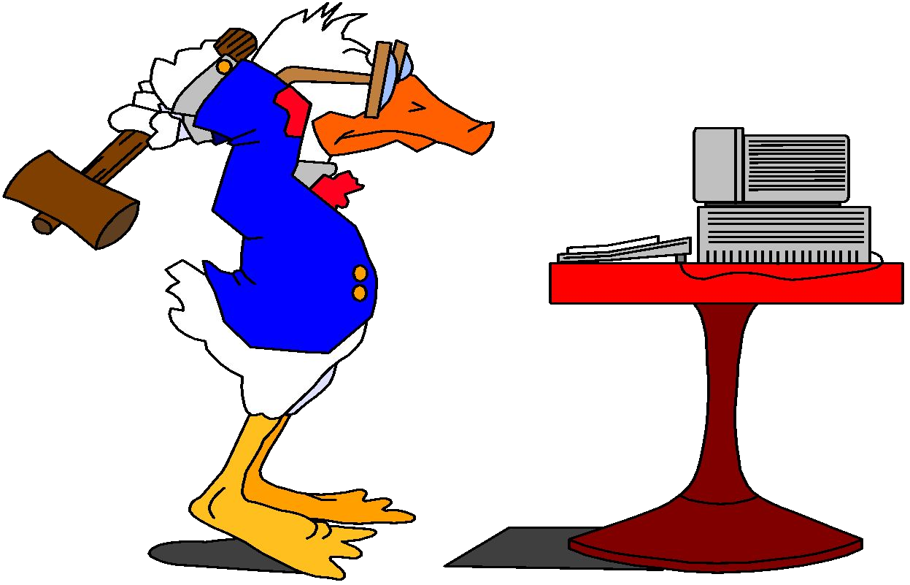
Conclusion
After completion of this lesson you should:
Write programs using java.lang.Exception package and your defined exceptions
Apply the principal:
If anything can go wrong, it will.

